Slide 1
Computer System
Lecture 02

Slide 2
Hardware
Mechanical devices in the computer are called Hardware or Anything that can be touched are called Hardware.
Inside Computer:
Motherboard
Central Processing Unit (CPU)
Random Access Memory (RAM)
Power Supply
Video Card
Hard Drive (HDD)
Solid-State Drive (SSD)
Optical Drive (e.g., BD/DVD/CD drive)
Card Reader (SD etc.)

Slide 3
Motherboard
The main printed circuit board in a computer is known as the motherboard. Other names for this central computer unit are system board, mainboard, or printed wired board (PWB). The motherboard is sometimes shortened to Mobo.
The type of motherboard installed in a PC has a great effect on a computer's system speed and expansion capabilities.

Slide 4
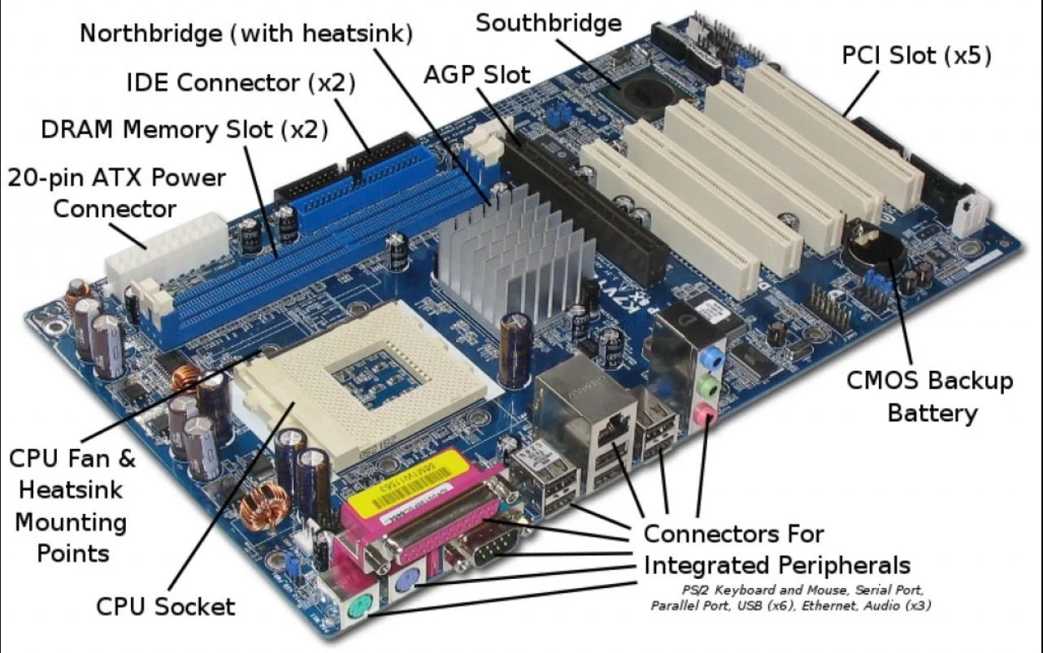

Slide 5
Major Motherboard Components and Their Functions
Central Processing Unit (CPU)
Random Access Memory (RAM)
Basic Input/Output System (BIOS)
Complimentary Metal Oxide Semiconductor Random Access Memory (CMOS RAM)
Cache Memory
Expansion Bus
Chipsets
CPU Clock
Switches and Jumpers

Slide 6
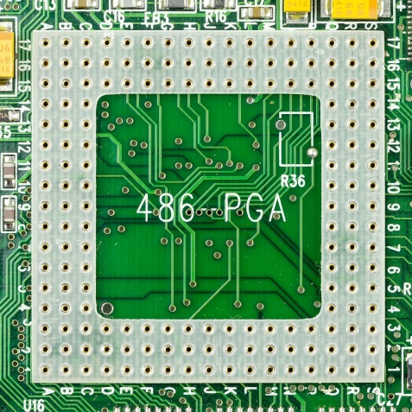
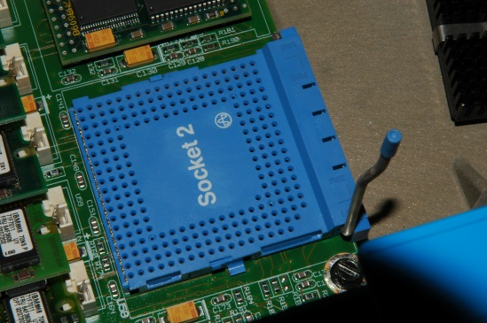
(1) Central Processing Unit (CPU)
CPU is also know as Computer's Microprocessor or the processor, the CPU is the computer's brain. It is responsible for fetching, decoding, and executing program instructions as well as performing mathematical and logical calculations.
The processor chip is identified by the processor type and the manufacturer. This information is usually inscribed on the chip itself. For example, Intel 386, Advanced Micro Devices (AMD) 386, Cyrix 486, Pentium MMX, Intel Core 2Duo, or iCore7.
If the processor chip is not on the motherboard, you can identify the processor socket as socket 1 to Socket 8, LGA 775 among others. This can help you identify the processor that fits in the socket. For example, a 486DX processor fits into Socket 3.

Slide 7
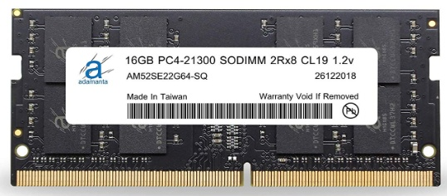
(2) Random Access Memory (RAM)
Random Access Memory, or RAM, usually refers to computer chips that temporarily store dynamic data to enhance computer performance while you are working.
In other words, it is the working place of your computer, where active programs and data are loaded so that any time the processor requires them, it doesn't have to fetch them from the hard disk.
Random access memory is volatile, meaning it loses its contents once power is turned off. This is different from non-volatile memory, such as hard disks and flash memory, which do not require a power source to retain data.
When a computer shuts down properly, all data located in RAM is returned back to permanent storage on the hard drive or flash drive. At the next boot-up, RAM begins to fill with programs automatically loaded at startup, a process called booting. Later on, the user opens other files and programs that are still loaded in the memory.

Slide 8
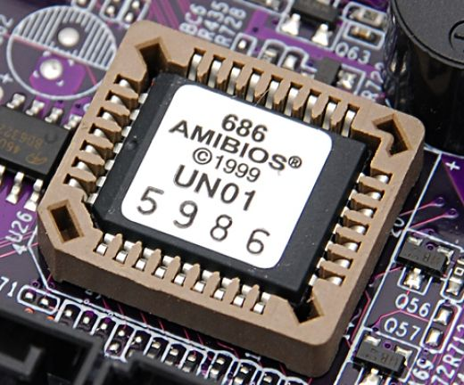
(3) Basic Input/Output System (BIOS)
BIOS stands for Basic Input/Output System. BIOS is a "read-only" memory, which consists of low-level software that controls the system hardware and acts as an interface between the operating system and the hardware. BIOS is essentially the link between the computer hardware and software in a system.
All motherboards include a small block of Read Only Memory (ROM) which is separate from the main system memory used for loading and running software. On PCs, the BIOS contains all the code required to control the keyboard, display screen, disk drives, serial communications, and a number of miscellaneous functions.
The system BIOS is a ROM chip on the motherboard used during the startup routine (boot process) to check out the system and prepare to run the hardware. The BIOS is stored on a ROM chip because ROM retains information even when no power is being supplied to the computer.

Slide 9
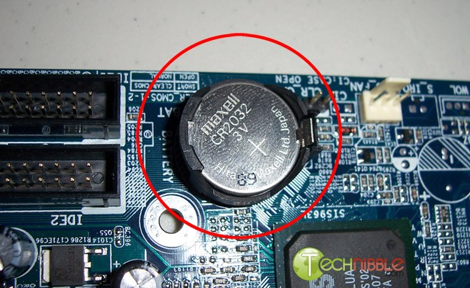
(4) Complimentary Metal Oxide Semiconductor Random Access Memory (CMOS RAM)
The CMOS Battery (Maxwell CR2032 3V)
Motherboards also include a small separate block of memory made from CMOS RAM chips which are kept alive by a battery (known as a CMOS battery) even when the PC’s power is off. This prevents reconfiguration when the PC is powered on.
CMOS devices require very little power to operate.
The CMOS RAM is used to store basic Information about the PC’s configuration for instance:-
Floppy disk and hard disk drive types
Information about CPU
RAM size
Date and time
Serial and parallel port information
Plug and Play information
Power Saving settings
Other Important data kept in CMOS memory is the time and date, which is updated by a Real Time Clock (RTC).

Slide 10
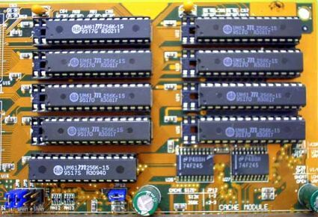
(5) Cache Memory
Cache memory is a small block of high-speed memory (RAM) that enhances PC performance by pre-loading information from the (relatively slow) main memory and passing it to the processor on demand.
Level 1: Most CPUs have an internal cache memory (built into the processor) which is referred to as Level 1 or primary cache memory.
Level 2: Cache Memory can be supplemented by external cache memory fitted on the motherboard. This is the Level 2 or secondary cache.
Level 3: In modern computers, Levels 1 and 2 cache memory are built into the processor die. If a third cache is implemented outside the die, it is referred to as the Level 3 (L3) cache.

Slide 11
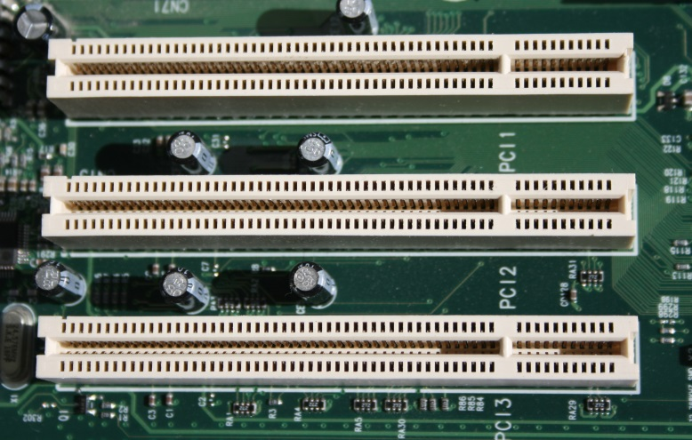
(6) Expansion Bus
An expansion bus is an input/output pathway from the CPU to peripheral devices and it is typically made up of a series of slots on the motherboard. Expansion boards (cards) plug into the bus. PCI (Peripheral Component Interconnect) is the most common expansion bus in a PC and other hardware platforms. Buses carry signals such as data, memory addresses, power, and control signals from component to component.
Expansion buses enhance the PCs capabilities by allowing users to add missing features in their computers by slotting adapter cards into expansion slots.

Slide 12
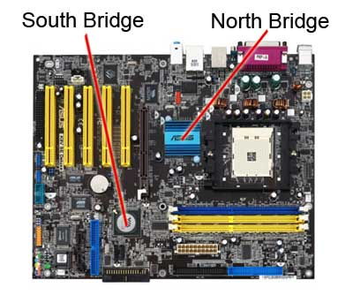
(7) Chipsets
A chipset is a group of small circuits that coordinate the flow of data to and from a PC's key components. These key components include the CPU itself, the main memory, the secondary cache, and any devices situated on the buses. A chipset also controls data flow to and from hard disks and other devices connected to the IDE(Integrated Development Environment) channels.
A computer has two main chipsets:
The NorthBridge (also called the memory controller) is in charge of controlling transfers between the processor and the RAM, which is why it is located physically near the processor. It is sometimes called the GMCH, for Graphic and Memory Controller Hub.
The SouthBridge (also called the input/output controller or expansion controller) handles communications between slower peripheral devices. It is also called the ICH (I/O Controller Hub). The term "bridge" is generally used to designate a component which connects two buses.
Chipset manufacturers include SIS, VIA, ALI, and OPTI.

Slide 13
(8) CPU Clock
The CPU clock synchronizes the operation of all parts of the PC and provides the basic timing signal for the CPU. Using a quartz crystal, the CPU clock breathes life into the microprocessor by feeding it a constant flow of pulses.
For example, a 200 MHz CPU receives 200 million pulses per second from the clock. A 2 GHz CPU gets two billion pulses per second. Similarly, in any communications device, a clock may be used to synchronize the data pulses between sender and receiver.
A "real-time clock," also called the "system clock," keeps track of the time of day and makes this data available to the software. A "time-sharing clock" interrupts the CPU at regular intervals and allows the operating system to divide its time between active users and/or applications.

Slide 14
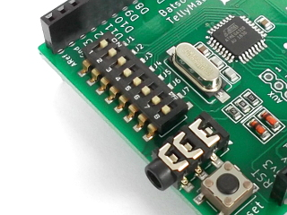
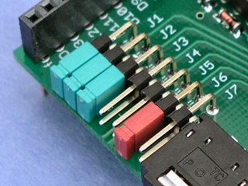
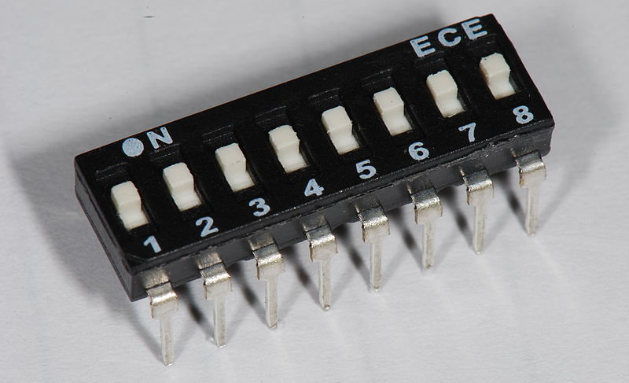
(9) Switches and Jumpers
DIP (Dual In-line Package) switches are small electronic switches found on the circuit board that can be turned on or off just like a normal switch. They are very small and so are usually flipped with a pointed object, such as the tip of a screwdriver, a bent paper clip, or a pen top. Take care when cleaning near DIP switches, as some solvents may destroy them. Dip switches are obsolete and you will not find them in modern systems.
Jumper pins are small protruding pins on the motherboard. A jumper cap or bridge is used to connect or short a pair of jumper pins. When the bridge is connected to any two pins, via a shorting link, it completes the circuit and a certain configuration has been achieved.
Jumper caps are metal bridges that close an electrical circuit. Typically, a jumper consists of a plastic plug that fits over a pair of protruding pins. Jumpers are sometimes used to configure expansion boards. By placing a jumper plug over a different set of pins, you can change a board's parameters.
NOTE: You can check the jumper pins and jumper cap at the back of an IDE hard disk and a CD/DVD ROM/Writer.

Slide 15
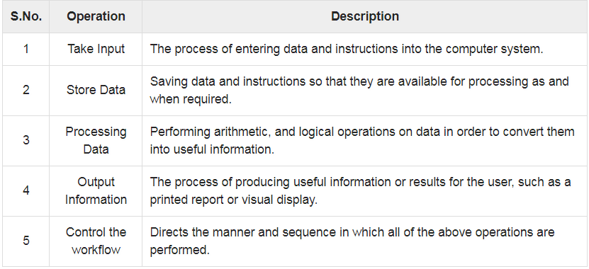
Basic Operations of a Computer
All types of computers follow the same basic logical structure and perform the following five basic operations for converting raw input data into information useful to their users.

Slide 16
Basic Operations of a Computer
Input Unit
This unit contains devices with the help of which we enter data into the computer. This unit creates a link between the user and the computer. The input devices translate the information into a form understandable by the computer.
Output Unit
The output unit consists of devices with the help of which we get the information from the computer. This unit is a link between the computer and the users. Output devices translate the computer's output into a form understandable by the users.

Slide 17
Basic Operations of a Computer
CPU (Central Processing Unit)
CPU is considered as the brain of the computer. CPU performs all types of data processing operations. It stores data, intermediate results, and instructions (program). It controls the operation of all parts of the computer.
CPU itself has the following three components −
ALU (Arithmetic Logic Unit)
Memory Unit
Control Unit

Slide 18
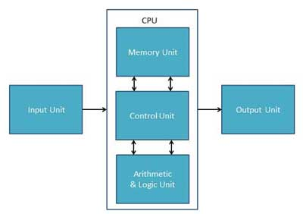
Basic Operations of a Computer

Slide 19
Components of a CPU
Memory or Storage Unit
This unit can store instructions, data, and intermediate results. This unit supplies information to other units of the computer when needed. It is also known as internal storage unit or the main memory or the primary storage or Random Access Memory (RAM).
Its size affects speed, power, and capability. Primary memory and secondary memory are two types of memories in the computer. Functions of the memory unit are −
It stores all the data and the instructions required for processing.
It stores intermediate results of processing.
It stores the final results of processing before these results are released to an output device.
All inputs and outputs are transmitted through the main memory.

Slide 20
Components of a CPU
Control Unit
This unit controls the operations of all parts of the computer but does not carry out any actual data processing operations.
Functions of this unit are −
It is responsible for controlling the transfer of data and instructions among other units of a computer.
It manages and coordinates all the units of the computer.
It obtains the instructions from the memory, interprets them, and directs the operation of the computer.
It communicates with Input/Output devices for transfer of data or results from storage.
It does not process or store data.

Slide 21
Components of a CPU
ALU (Arithmetic Logic Unit)
This unit consists of two subsections namely,
Arithmetic Section
Logic Section
Arithmetic Section
Function of arithmetic section is to perform arithmetic operations like addition, subtraction, multiplication, and division. All complex operations are done by making repetitive use of the above operations.
Logic Section
Function of logic section is to perform logic operations such as comparing, selecting, matching, and merging of data.

Slide 22
Input Devices
Following are some of the important input devices which are used in a computer −
Keyboard
Mouse
Joy Stick
Light pen
Track Ball
Scanner
Graphic Tablet
Microphone
Magnetic Ink Card Reader(MICR)
Optical Character Reader(OCR)
Bar Code Reader
Optical Mark Reader(OMR)

Slide 23
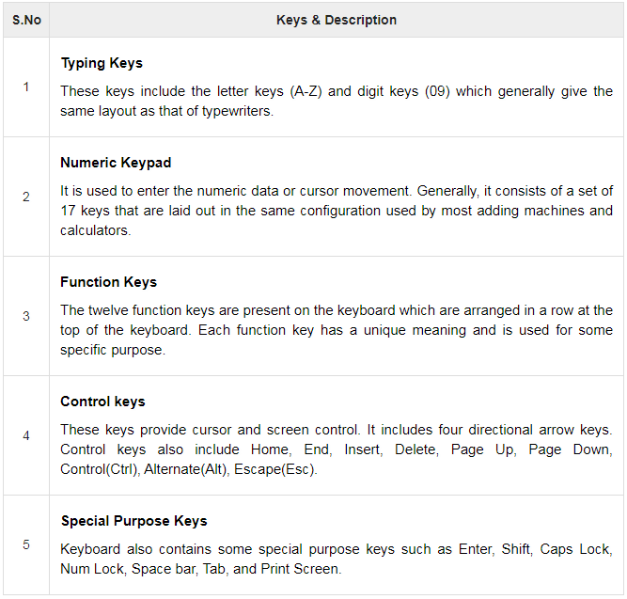
Input Devices
Keyboard
Keyboard is the most common and very popular input device which helps to input data to the computer. The layout of the keyboard is like that of traditional typewriter, although there are some additional keys provided for performing additional functions.
Mouse
Mouse is the most popular pointing device. It is a very famous cursor-control device having a small palm size box with a round ball at its base, which senses the movement of the mouse and sends corresponding signals to the CPU when the mouse buttons are pressed.
Generally, it has two buttons called the left and the right button and a wheel is present between the buttons. A mouse can be used to control the position of the cursor on the screen, but it cannot be used to enter text into the computer.

Slide 24
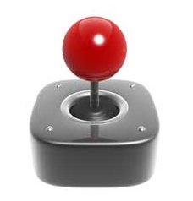

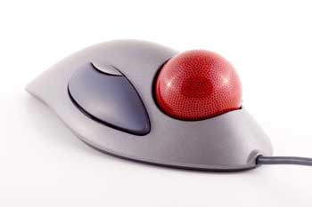
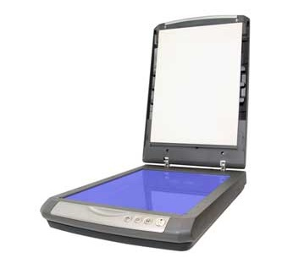
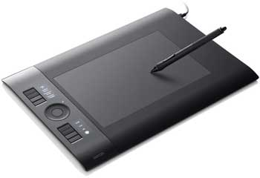
Input Devices
Joystick
Joystick is also a pointing device, which is used to move the cursor position on a monitor screen. It is a stick having a spherical ball at its both lower and upper ends. The lower spherical ball moves in a socket. The joystick can be moved in all four directions.
Light Pen
Light pen is a pointing device similar to a pen. It is used to select a displayed menu item or draw pictures on the monitor screen. It consists of a photocell and an optical system placed in a small tube.
Track Ball
Track ball is an input device that is mostly used in notebook or laptop computer, instead of a mouse. This is a ball which is half inserted and by moving fingers on the ball, the pointer can be moved.
Scanner
Scanner is an input device, which works more like a photocopy machine. It is used when some information is available on paper and it is to be transferred to the hard disk of the computer for further manipulation.
Digitizer
Digitizer is an input device which converts analog information into digital form. Digitizer can convert a signal from the television or camera into a series of numbers that could be stored in a computer. They can be used by the computer to create a picture of whatever the camera had been pointed at.

Slide 25
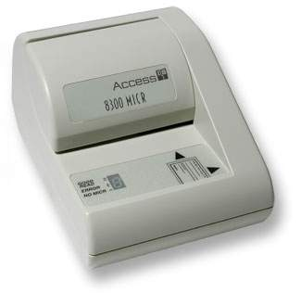
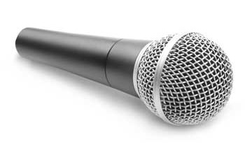
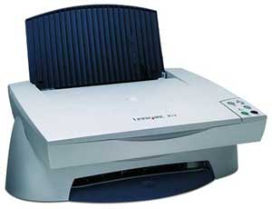
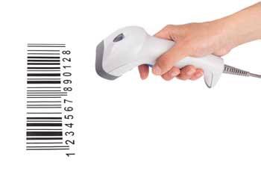
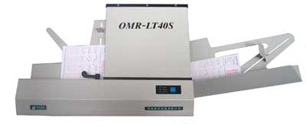
Input Devices
Microphone
Microphone is an input device to input sound that is then stored in a digital form. The microphone is used for various applications such as adding sound to a multimedia presentation or for mixing music.
Magnetic Ink Card Reader (MICR)
MICR input device is generally used in banks as there are large number of cheques to be processed every day. The bank's code number and cheque number are printed on the cheques with a special type of ink that contains particles of magnetic material that are machine readable.
This reading process is called Magnetic Ink Character Recognition (MICR). The main advantages of MICR is that it is fast and less error prone.
Optical Character Reader (OCR)
OCR is an input device used to read a printed text. OCR scans the text optically, character by character, converts them into a machine readable code, and stores the text on the system memory.
Bar Code Readers
Bar Code Reader is a device used for reading bar coded data (data in the form of light and dark lines). Bar coded data is generally used in labelling goods, numbering the books, etc. It may be a handheld scanner or may be embedded in a stationary scanner.
Bar Code Reader scans a bar code image, converts it into an alphanumeric value, which is then fed to the computer that the bar code reader is connected to.
Optical Mark Reader (OMR)
OMR is a special type of optical scanner used to recognize the type of mark made by pen or pencil. It is used where one out of a few alternatives is to be selected and marked.
It is specially used for checking the answer sheets of examinations having multiple choice questions.

Slide 26
Output Devices
Following are some of the important output devices used in a computer.
Monitors
Graphic Plotter
Printer

Slide 27
Output Devices
Monitors
Monitors, commonly called as Visual Display Unit (VDU), are the main output device of a computer. It forms images from tiny dots, called pixels that are arranged in a rectangular form. The sharpness of the image depends upon the number of pixels.
There are two kinds of viewing screen used for monitors.
Cathode-Ray Tube (CRT)
Flat-Panel Display
Cathode-Ray Tube (CRT) Monitor
The CRT display is made up of small picture elements called pixels. The smaller the pixels, the better the image clarity or resolution. It takes more than one illuminated pixel to form a whole character, such as the letter ‘e’ in the word help.
A finite number of characters can be displayed on a screen at once. The screen can be divided into a series of character boxes - fixed location on the screen where a standard character can be placed. Most screens are capable of displaying 80 characters of data horizontally and 25 lines vertically.
There are some disadvantages of CRT −
Large in Size
High power consumption

Slide 28
Output Devices
Flat-Panel Display Monitor
The flat-panel display refers to a class of video devices that have reduced volume, weight and power requirement in comparison to the CRT. You can hang them on walls or wear them on your wrists. Current uses of flat-panel displays include calculators, video games, monitors, laptop computer, and graphics display.
The flat-panel display is divided into two categories −
Emissive Displays − Emissive displays are devices that convert electrical energy into light. For example, plasma panel and LED (Light-Emitting Diodes).
Non-Emissive Displays − Non-emissive displays use optical effects to convert sunlight or light from some other source into graphics patterns. For example, LCD (Liquid-Crystal Device).

Slide 29
Output Devices
Printers
Printer is an output device, which is used to print information on paper. There are two types of printers −
Impact Printers: Impact printers print the characters by striking them on the ribbon, which is then pressed on the paper. These printers are of two types −
Character printers: Character printers are the printers which print one character at a time. These are further divided into two types:
Dot Matrix Printer(DMP): Each character printed is in the form of pattern of dots and head consists of a Matrix of Pins of size (5*7, 7*9, 9*7 or 9*9) which come out to form a character which is why it is called Dot Matrix Printer.
Daisy Wheel: Head is lying on a wheel and pins corresponding to characters are like petals of Daisy (flower) which is why it is called Daisy Wheel Printer. These printers are generally used for word-processing in offices that require a few letters to be sent here and there with very nice quality.
Line printers: Line printers are the printers which print one line at a time. These are of two types −
Drum Printer: This printer is like a drum in shape hence it is called drum printer. The surface of the drum is divided into a number of tracks. Total tracks are equal to the size of the paper, i.e. for a paper width of 132 characters, drum will have 132 tracks. A character set is embossed on the track. Different character sets available in the market are 48 character set, 64 and 96 characters set. One rotation of drum prints one line. Drum printers are fast in speed and can print 300 to 2000 lines per minute.
Chain Printer: In this printer, a chain of character sets is used, hence it is called Chain Printer. A standard character set may have 48, 64, or 96 characters.
Non-impact Printers: Non-impact printers print the characters without using the ribbon. These printers print a complete page at a time, thus they are also called as Page Printers. These printers are of two types −
Laser Printers: These are non-impact page printers. They use laser lights to produce the dots needed to form the characters to be printed on a page.
Inkjet Printers: Inkjet printers are non-impact character printers based on a relatively new technology. They print characters by spraying small drops of ink onto paper. Inkjet printers produce high quality output with presentable features.

Slide 30
Computer - Memory
A memory is just like a human brain. It is used to store data and instructions. Computer memory is the storage space in the computer, where data is to be processed and instructions required for processing are stored. The memory is divided into large number of small parts called cells. Each location or cell has a unique address, which varies from zero to memory size minus one.
For example, if the computer has 64k. A kilobyte (KB) is 1,024 bytes
then this memory unit has 64 * 1024 = 65536 memory locations.
The address of these locations varies from 0 to 65535.
Memory is primarily of three types −
Cache Memory
Primary Memory/Main Memory
Secondary Memory

Slide 31
Computer - Memory
Cache Memory
Cache memory is a very high speed semiconductor memory which can speed up the CPU. It acts as a buffer between the CPU and the main memory. It is used to hold those parts of data and program which are most frequently used by the CPU. The parts of data and programs are transferred from the disk to cache memory by the operating system, from where the CPU can access them.
Advantages
The advantages of cache memory are as follows −
Cache memory is faster than main memory.
It consumes less access time as compared to main memory.
It stores the program that can be executed within a short period of time.
It stores data for temporary use.
Disadvantages
The disadvantages of cache memory are as follows −
Cache memory has limited capacity.
It is very expensive.

Slide 32
Computer - Memory
Primary Memory (Main Memory)
Primary memory holds only those data and instructions on which the computer is currently working. It has a limited capacity and data is lost when power is switched off. It is generally made up of semiconductor device. These memories are not as fast as registers. The data and instruction required to be processed resides in the main memory. It is divided into two subcategories RAM and ROM.
Characteristics of Main Memory
These are semiconductor memories.
It is known as the main memory.
Usually volatile memory.
Data is lost in case power is switched off.
It is the working memory of the computer.
Faster than secondary memories.
A computer cannot run without the primary memory.

Slide 33
Computer - Memory
Secondary Memory
This type of memory is also known as external memory or non-volatile. It is slower than the main memory. These are used for storing data/information permanently. CPU directly does not access these memories, instead they are accessed via input-output routines. The contents of secondary memories are first transferred to the main memory, and then the CPU can access it. For example, disk, CD-ROM, DVD, etc.
Characteristics of Secondary Memory
These are magnetic and optical memories.
It is known as the backup memory.
It is a non-volatile memory.
Data is permanently stored even if power is switched off.
It is used for storage of data in a computer.
Computer may run without the secondary memory.
Slower than primary memories.

Slide 34
Random Access Memory
RAM (Random Access Memory) is the internal memory of the CPU for storing data, program, and program result. It is a read/write memory which stores data until the machine is working. As soon as the machine is switched off, data is erased.
Access time in RAM is independent of the address, that is, each storage location inside the memory is as easy to reach as other locations and takes the same amount of time. Data in the RAM can be accessed randomly but it is very expensive.
RAM is volatile, i.e. data stored in it is lost when we switch off the computer or if there is a power failure. Hence, a backup Uninterruptible Power System (UPS) is often used with computers. RAM is small, both in terms of its physical size and in the amount of data it can hold.
RAM is of two types −
Static RAM (SRAM)
Dynamic RAM (DRAM)

Slide 35
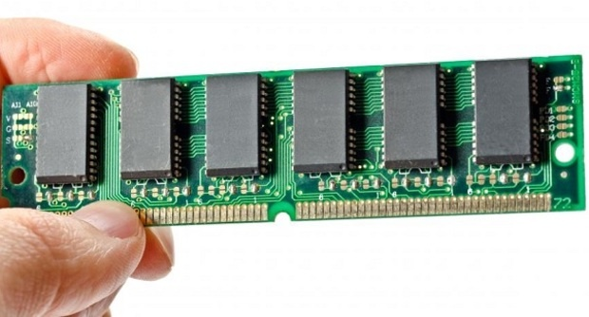
Random Access Memory
Static RAM (SRAM)
The word static indicates that the memory retains its contents as long as power is being supplied. However, data is lost when the power gets down due to volatile nature. SRAM chips use a matrix of 6-transistors and no capacitors. Transistors do not require power to prevent leakage, so SRAM need not be refreshed on a regular basis.
There is extra space in the matrix, hence SRAM uses more chips than DRAM for the same amount of storage space, making the manufacturing costs higher. SRAM is thus used as cache memory and has very fast access.
Characteristic of Static RAM
Long life
No need to refresh
Faster
Used as cache memory
Large size
Expensive
High power consumption

Slide 36
Random Access Memory
Dynamic RAM (DRAM)
DRAM, unlike SRAM, must be continually refreshed in order to maintain the data. This is done by placing the memory on a refresh circuit that rewrites the data several hundred times per second. DRAM is used for most system memory as it is cheap and small. All DRAMs are made up of memory cells, which are composed of one capacitor and one transistor.
Characteristics of Dynamic RAM
Short data lifetime
Needs to be refreshed continuously
Slower as compared to SRAM
Used as RAM
Smaller in size
Less expensive
Less power consumption

Slide 37
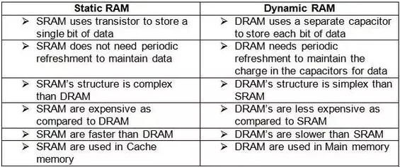
Difference b/w SRAM and DRAM

Slide 38
Computer - Read Only Memory
ROM stands for Read Only Memory. The memory from which we can only read but cannot write on it. This type of memory is non-volatile. The information is stored permanently in such memories during manufacture. A ROM stores such instructions that are required to start a computer. This operation is referred to as bootstrap. ROM chips are not only used in the computer but also in other electronic items like washing machine and microwave oven.
Advantages of ROM
The advantages of ROM are as follows −
Non-volatile in nature
Cannot be accidentally changed
Cheaper than RAMs
Easy to test
More reliable than RAMs
Static and do not require refreshing
Contents are always known and can be verified

Slide 39
Computer - Read Only Memory
PROM (Programmable Read Only Memory)
Short for programmable read-only memory, a memory chip on which data can be written only once. Once a program has been written onto a PROM, it remains there forever. Unlike RAM, PROMs retain their contents when the computer is turned off. The difference between a PROM and a ROM (read-only memory) is that a PROM is manufactured as blank memory, whereas a ROM is programmed during the manufacturing process. To write data onto a PROM chip, you need a special device called a PROM programmer or PROM burner. The process of programming a PROM is sometimes called burning the PROM.

Slide 40
Computer - Read Only Memory
EPROM (Erasable and Programmable Read Only Memory)
Acronym for erasable programmable read-only memory, and pronounced ee-prom, EPROM is a special type of memory that retains its contents until it is exposed to ultraviolet light. The ultraviolet light clears its contents, making it possible to reprogram the memory. To write to and erase an EPROM, you need a special device called a PROM programmer or PROM burner.
Process of Programming: EPROM can be erased by exposing it to ultra-violet light for a duration of up to 40 minutes. During programming, an electrical charge is trapped in an insulated gate region. The charge is retained for more than 10 years because the charge has no leakage path. For erasing this charge, ultra-violet light is passed through a quartz crystal window (lid). This exposure to ultra-violet light dissipates the charge. During normal use, the quartz lid is sealed with a sticker.

Slide 41
Computer - Read Only Memory
EEPROM (Electrically Erasable and Programmable Read Only Memory)
Short form of electrically erasable programmable read-only memory. EEPROM is a special type of PROM that can be erased by exposing it to an electrical charge. Like other types of PROM, EEPROM retains its contents even when the power is turned off. Also like other types of ROM, EEPROM is not as fast as RAM.
It can be erased and reprogrammed about ten thousand times. Both erasing and programming take about 4 to 10 ms (millisecond). In EEPROM, any location can be selectively erased and programmed. EEPROMs can be erased one byte at a time, rather than erasing the entire chip. Hence, the process of reprogramming is flexible but slow.

